Slide 1


Electronic Page Turner
ECE 445 Presentation
Team 7
Adia Radecka, Alyssa Bradshaw, Javi Cardenas
May 3, 2023
Notes:
Javi

Slide 2


Motivation
Problem
Reading and multitasking can be difficult
Cooking using a cookbook
Playing an instrument
Problems of Existing Solutions
Limited pages
Only turns 10 pages in one direction
Extensive setup
Must attach individual pages to the device
Expensive
Can exceed over $500
ELECTRICAL & COMPUTER ENGINEERING
GRAINGER ENGINEERING
Notes:
Javi

Slide 3
Our Solution
High Level Requirements
The device must be able to turn one page within 5 seconds ± 2 seconds. This motion should be repeatable for turning a page backward.
The device must be able to turn at least ten consecutive pages, with 95% ± 5% accuracy, and take at most 1 minute ± 10 seconds when the foot pedal is pressed consecutively.
The device must be able to store the total number of pages turned in a single sitting, with 95% ± 5% accuracy, and display this information to the reader.
ELECTRICAL & COMPUTER ENGINEERING
GRAINGER ENGINEERING
Notes:
Javi

Slide 4
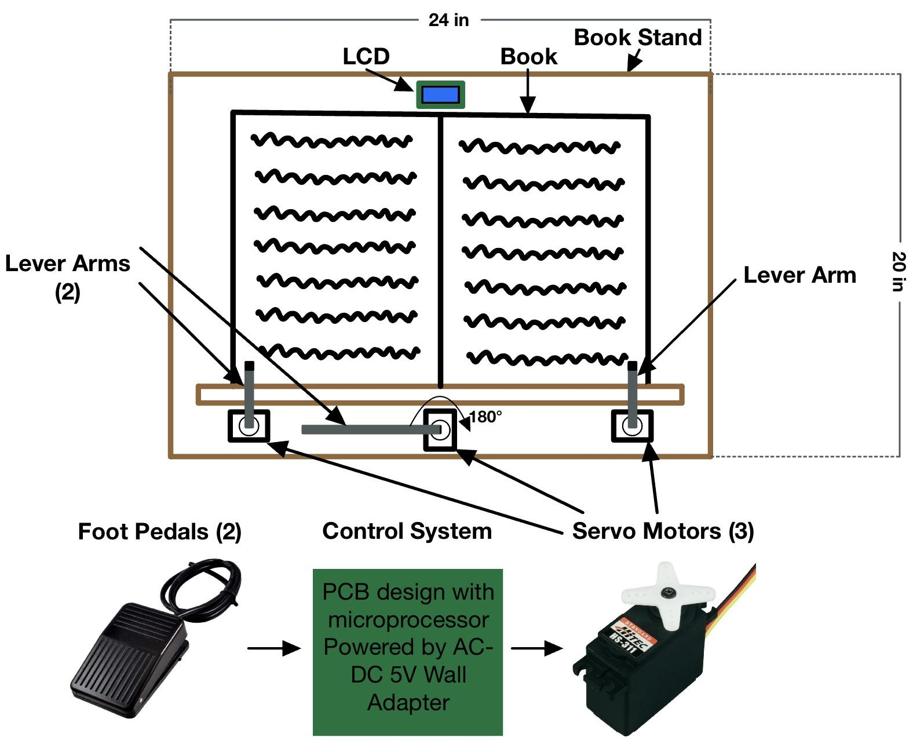
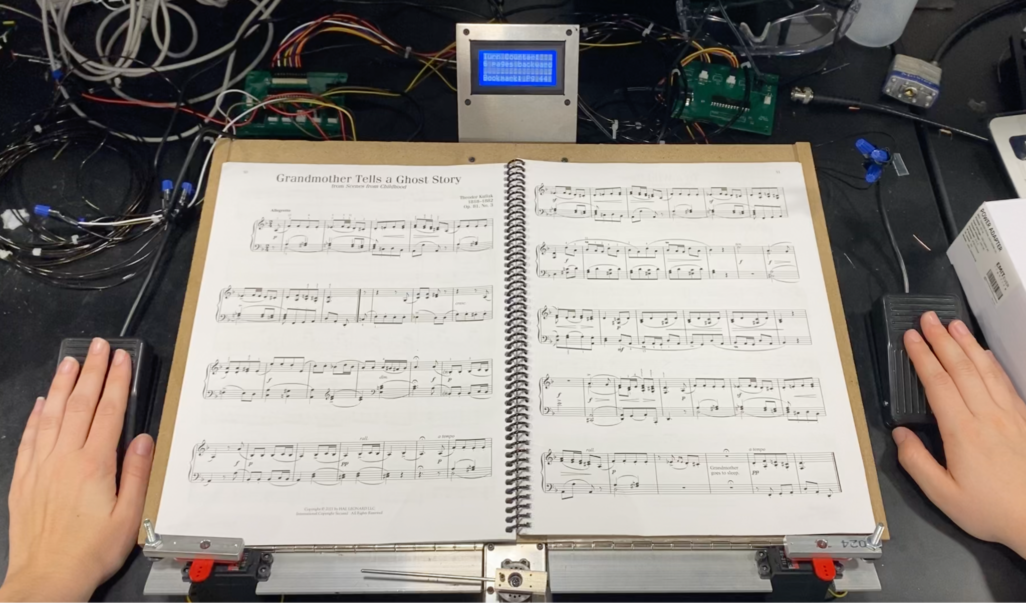
Project Images
Design Sketch
Physical Device
Foot Pedals User Interface PCB’S Lifting Motors Turning Motor
ELECTRICAL & COMPUTER ENGINEERING
GRAINGER ENGINEERING
Notes:
Javi

Slide 5
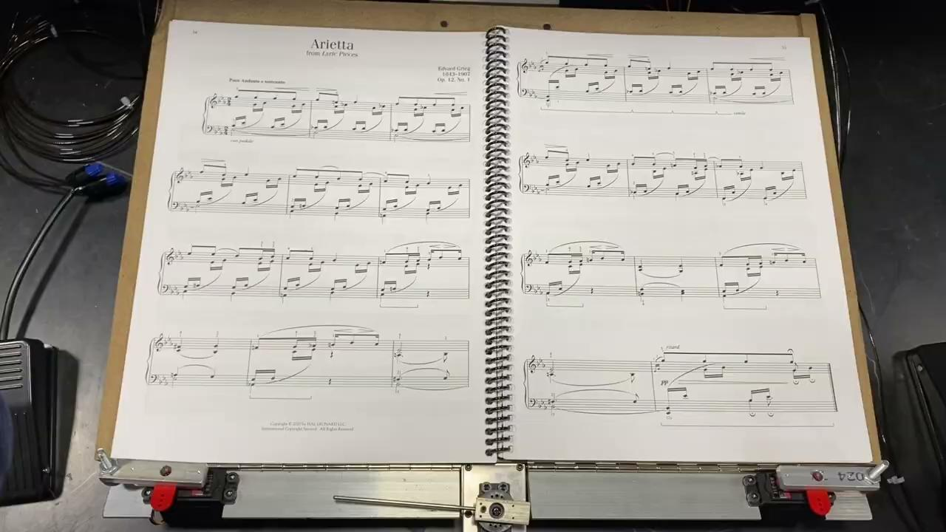
Functionality
One Page Forward and One Page Backward
ELECTRICAL & COMPUTER ENGINEERING
GRAINGER ENGINEERING
Notes:
Adia

Slide 6
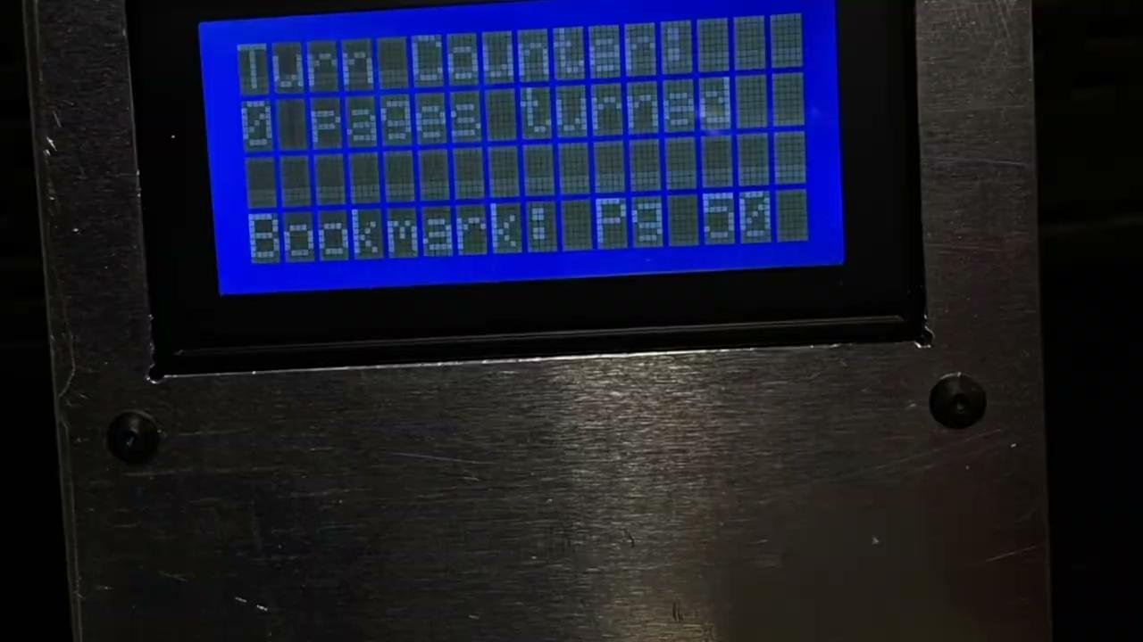
Functionality
LCD Output
ELECTRICAL & COMPUTER ENGINEERING
GRAINGER ENGINEERING
Notes:
Adia

Slide 7
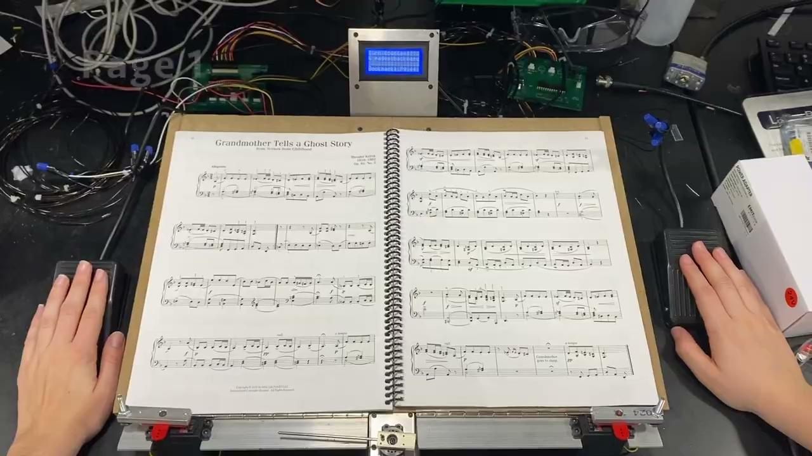
Short Demo Video
10 Consecutive Pages in 1 Minute
ELECTRICAL & COMPUTER ENGINEERING
GRAINGER ENGINEERING
Notes:
Adia

Slide 8
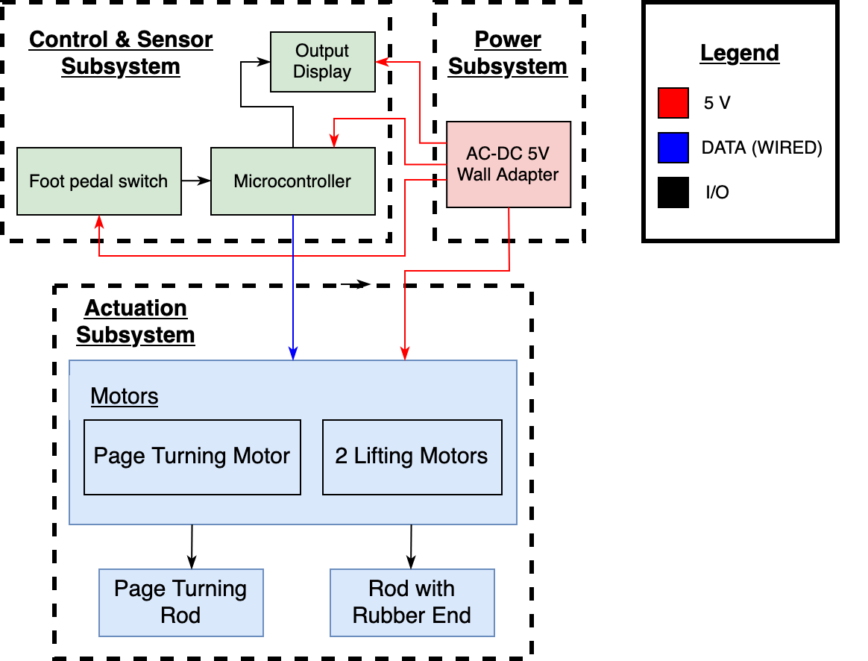
Block Diagram
Three Subsystems: Power, Actuation, and Control & Sensors
ELECTRICAL & COMPUTER ENGINEERING
GRAINGER ENGINEERING
Notes:
Adia

Slide 9
Power Subsystem
Adia Radecka
ELECTRICAL & COMPUTER ENGINEERING
GRAINGER ENGINEERING
Notes:
Adia

Slide 10
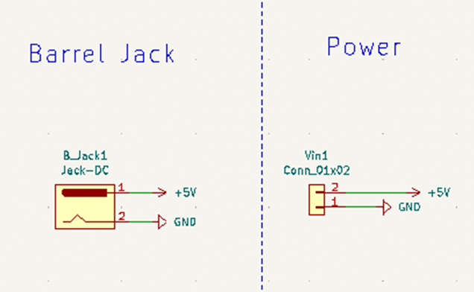
Power: RV Table
Power Subsystem
Requirements | Verification
Must have a 5V wall adapter that plugs into a wall outlet. All components on the PCB must be supplied with 5 V ± 5%, when the device is idle and active. | Use a multimeter to check that the wall adapter barrel jack is supplying 5V ± 5%. Measure the voltage across each component using an oscilloscope. Repeat this process when a foot pedal is pressed.
ELECTRICAL & COMPUTER ENGINEERING
GRAINGER ENGINEERING
Notes:
Adia

Slide 11
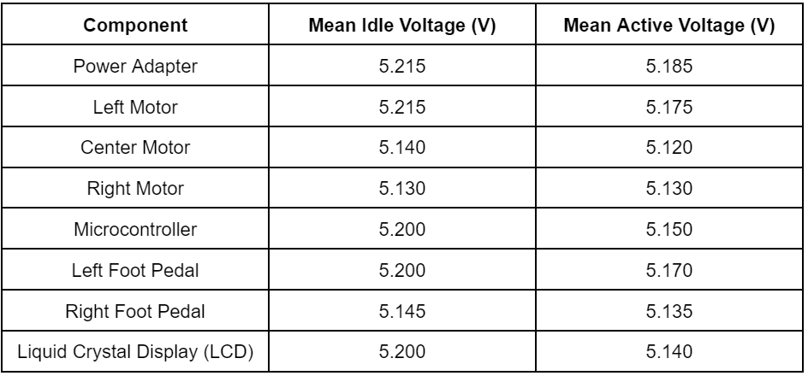
Power
5V AC-DC Wall Adapter
Supplied 5V ± 5% DC to all components
Oscilloscope Testing Data
ELECTRICAL & COMPUTER ENGINEERING
GRAINGER ENGINEERING
Notes:
Adia

Slide 12
Challenges
ELECTRICAL & COMPUTER ENGINEERING
GRAINGER ENGINEERING
Notes:
Adia

Slide 13
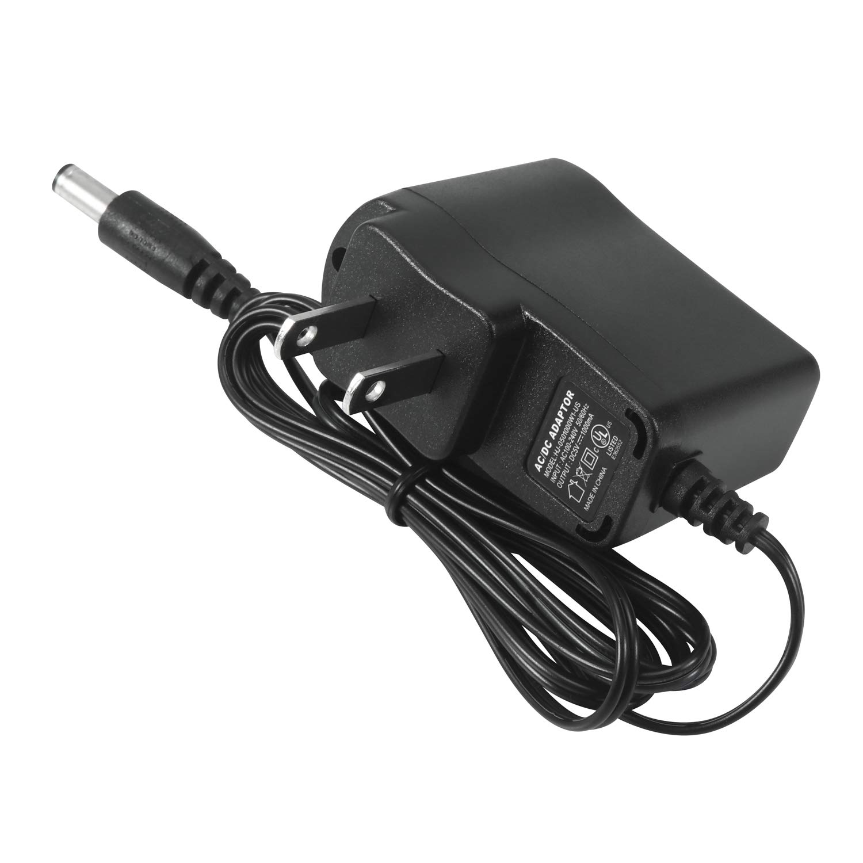
Power Design Issues
9V Li-ion Batteries
Batteries have internal resistance
Active motors drain more current
Causes the actual voltage supplied to drop
Buck Converter (DC-DC converter)
Originally using a 12V wall adapter
Foot pedals needed 12V
Motors needed 6V
Microcontroller needed 3.3V
Solution
5V wall adapter and chose components that operate at 5V
ELECTRICAL & COMPUTER ENGINEERING
GRAINGER ENGINEERING
Notes:
Adia
We used a 5V power supply, we added capacitors to the motors to reduce voltage drop

Slide 14
Actuation Subsystem
Alyssa Bradshaw
ELECTRICAL & COMPUTER ENGINEERING
GRAINGER ENGINEERING
Notes:
Alyssa

Slide 15
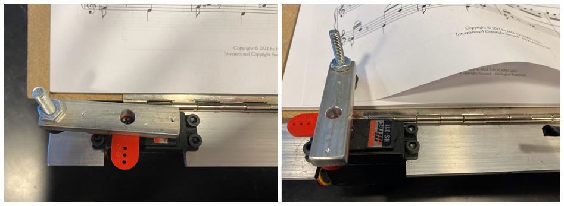

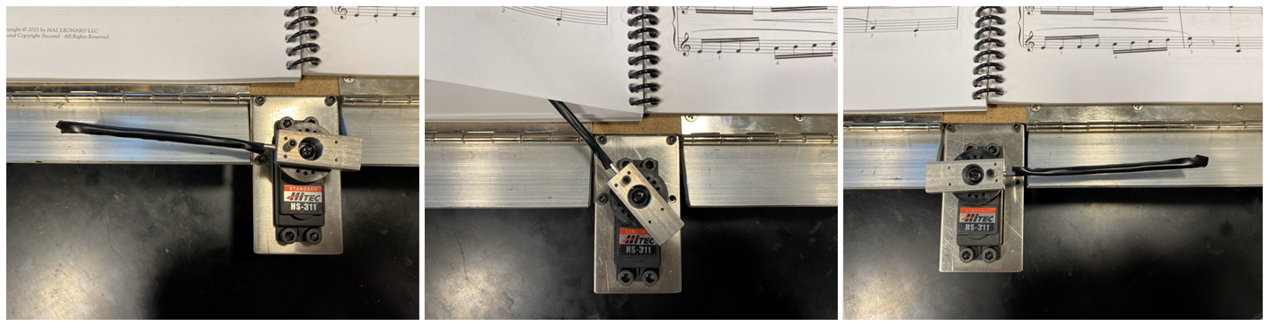
Actuation Subsystem
HiTEC HS-311 Servo Motors (3)
Lifting Motor(2)
Operating Voltage Range | 4.8 - 6.0 V
Range of Motion | 0-180°
Sweeping Motor
ELECTRICAL & COMPUTER ENGINEERING
GRAINGER ENGINEERING
Notes:
Alyssa

Slide 16
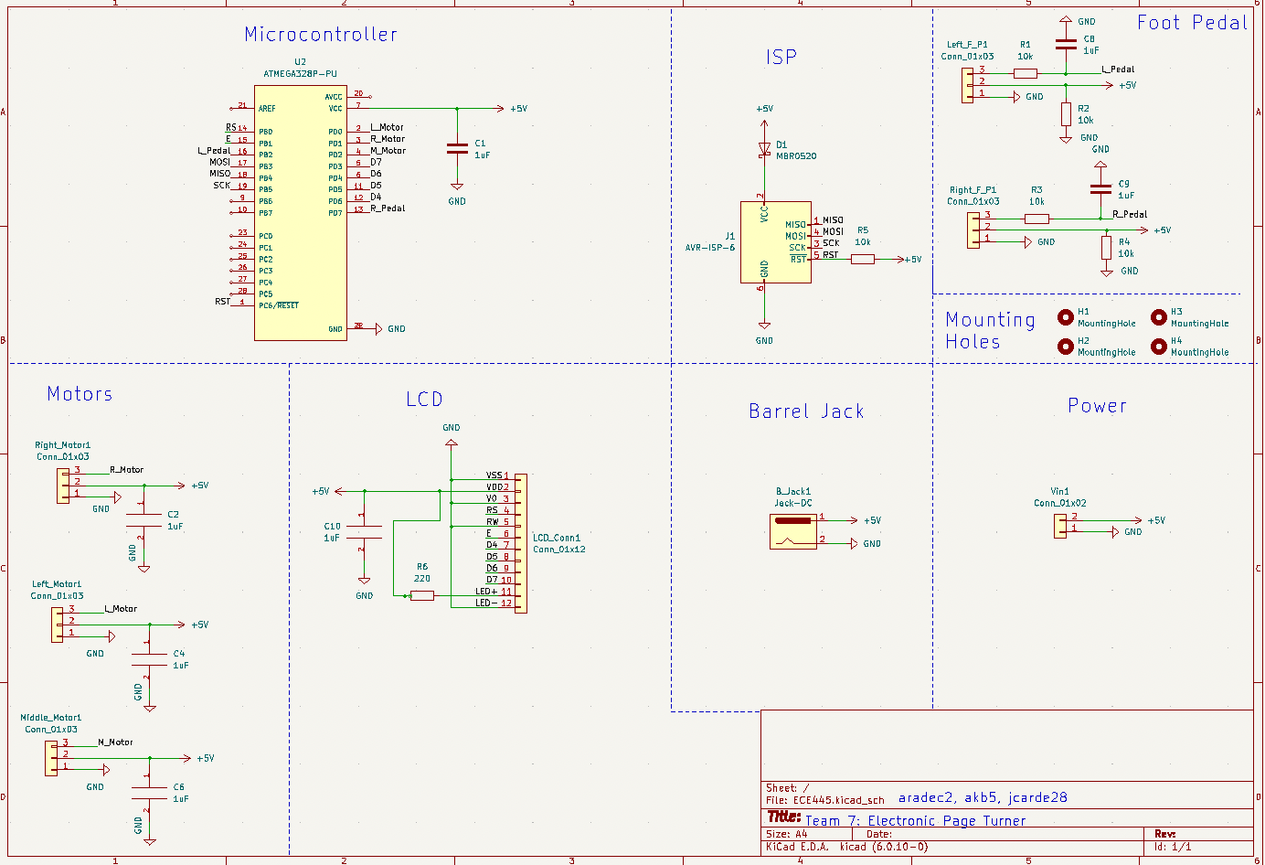
Design: Data Collection
Actuation Subsystem
Requirement | Verification
The servo motors must create negligible backwards EMF. The motors should cause minimal to no damage or tearing to the pages in the book. | Use an oscilloscope to plot the voltage of a motor when idle and when active. If the voltage spike is less than 1V ± 0.5V, we can consider the backwards EMF from the motor to be negligible. Run 10 test trials to find the best angle and speed for each motor.
ELECTRICAL & COMPUTER ENGINEERING
GRAINGER ENGINEERING
Notes:
Alyssa

Slide 17
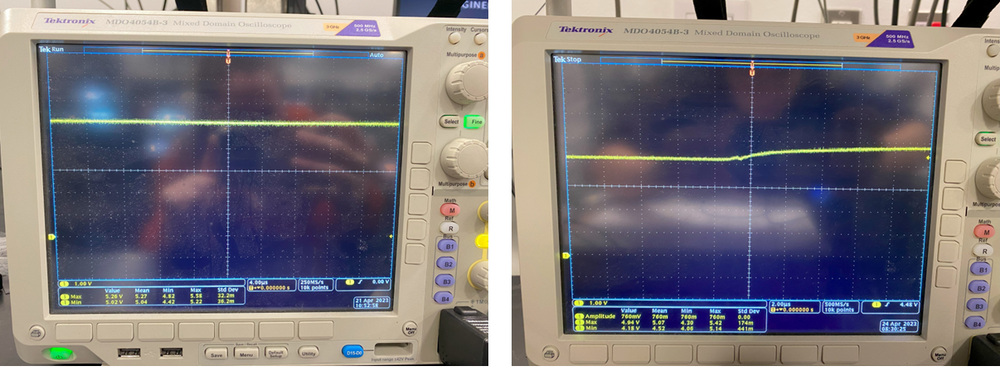
Power Testing
Oscilloscope Testing - Negligible Backwards EMF
Steady 5 Volts
Voltage Drop of 760 mV
ELECTRICAL & COMPUTER ENGINEERING
GRAINGER ENGINEERING
Notes:
Alyssa

Slide 18
Challenges
ELECTRICAL & COMPUTER ENGINEERING
GRAINGER ENGINEERING
Notes:
Alyssa

Slide 19
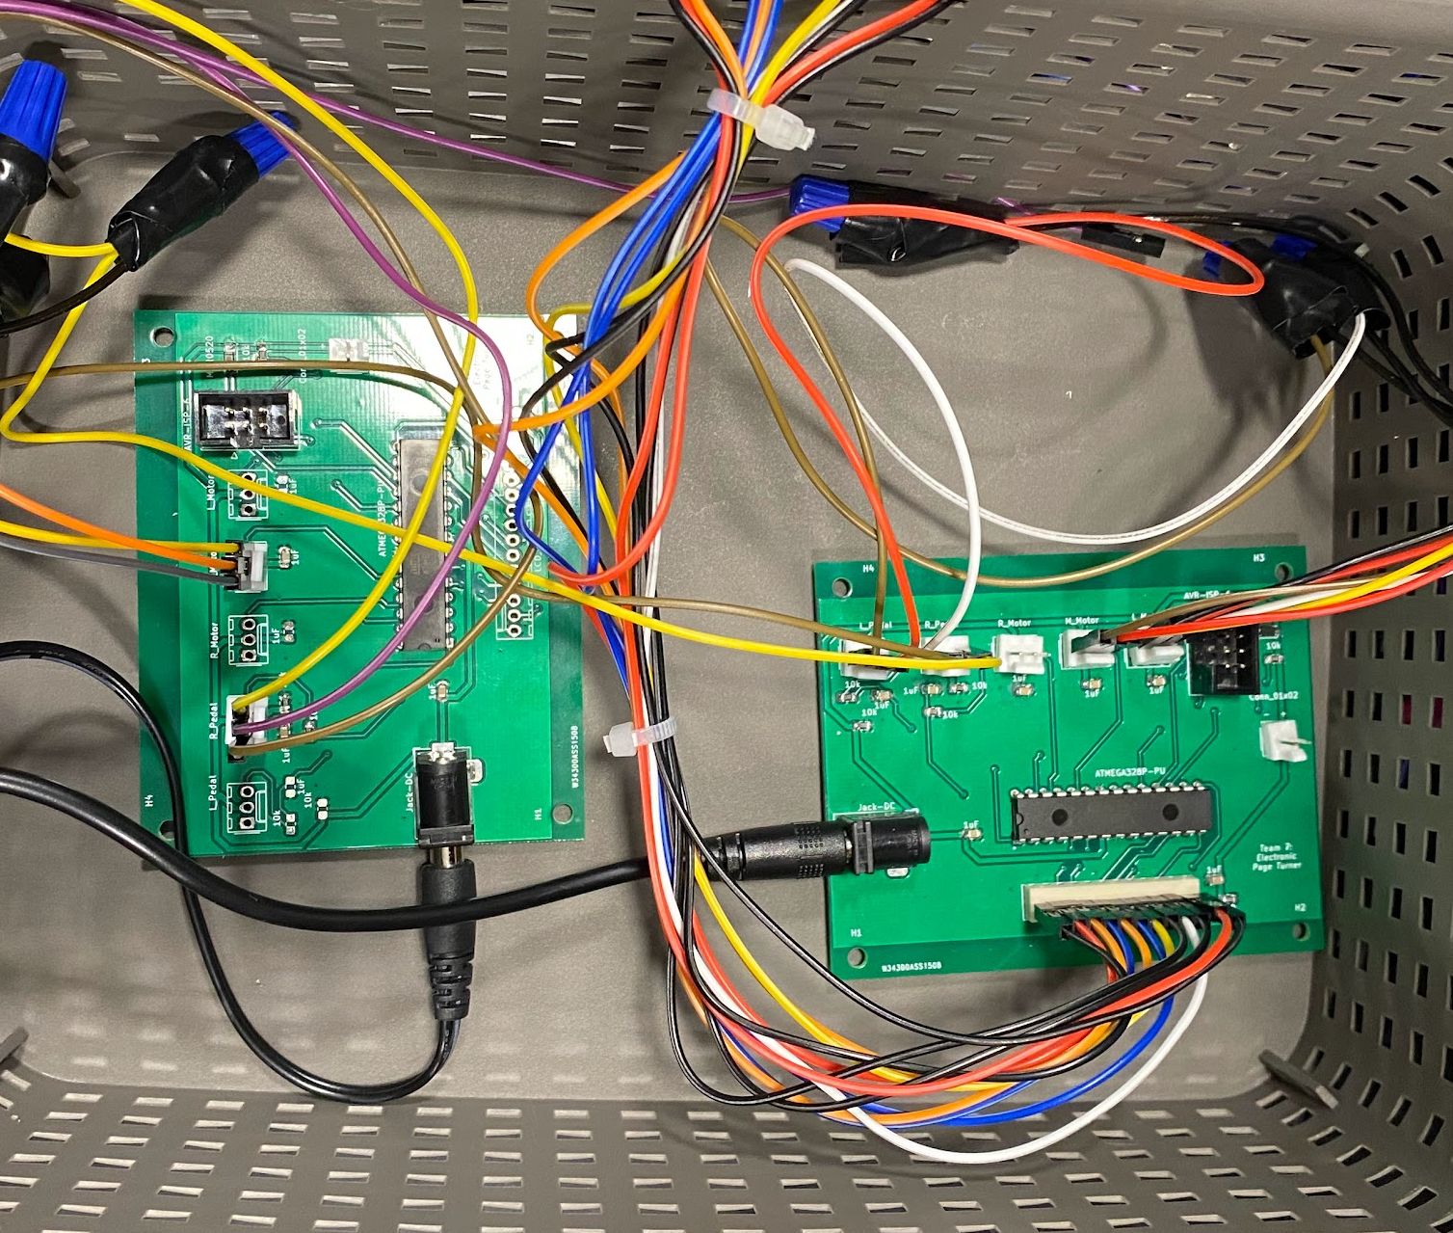
Original Design Issues
PCB Issue (1)
Initially right motor would not work when connecting all components to one PCB
Solution
Used a second PCB to control this motor
Two separate programs for each MCU
Center and right motor had to be in sync
Better approach
1 PCB with two Microcontrollers
PCB Issue (2)
Right motor stopped working on 2nd PCB
Solution
Rewired all connections
Soldered a new 2nd PCB
ELECTRICAL & COMPUTER ENGINEERING
GRAINGER ENGINEERING
Notes:
Alyssa

Slide 20
Control & Sensor Subsystem
Javi Cardenas
ELECTRICAL & COMPUTER ENGINEERING
GRAINGER ENGINEERING
Notes:
Javi

Slide 21
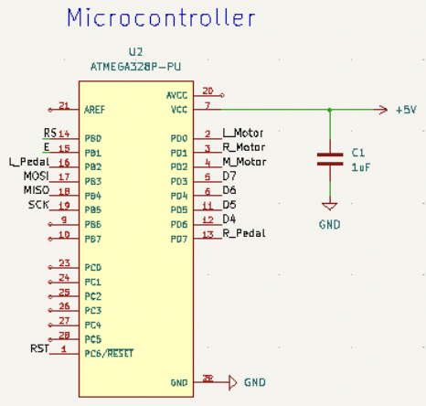
Control & Sensors
R&V Table
Requirements | Verification
When the left foot pedal is pressed, the motors should turn a page backward. When the right foot pedal is pressed, the motors should turn a page forward. The LCD should track the number of pages turned forward. | Ensure that the left motor rotates 45°-135°-45° and the center motor rotates 0°-90°-180° when the left pedal is pressed. Ensure that the right motor rotates 135°-45°-135° and the center motor rotates 180°-90°-0° when the right pedal is pressed. When the right foot pedal is pressed, the count should increase by 1. If the left foot pedal is pressed, the count should decrease by 1.
ELECTRICAL & COMPUTER ENGINEERING
GRAINGER ENGINEERING
Notes:
Javi

Slide 22
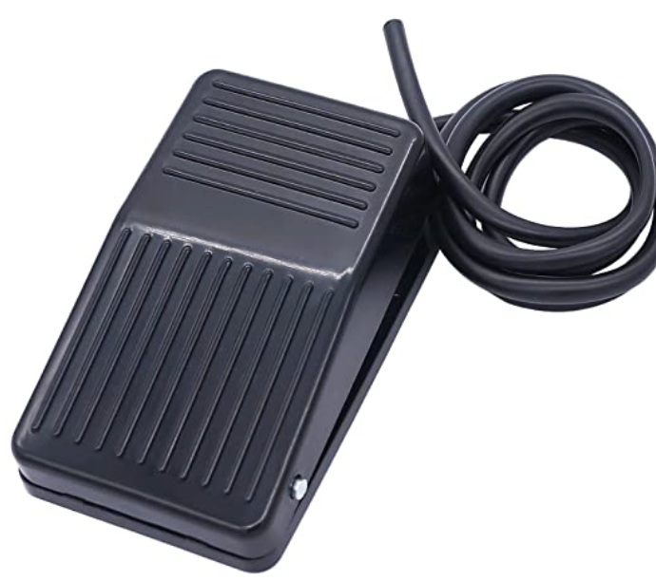
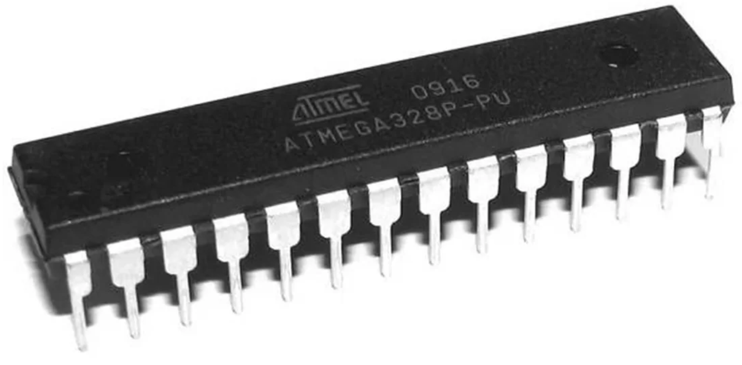

Control & Sensors
Twidec Foot Pedal Switches
ATMEGA328P
Microcontroller
Focus 16x4 Liquid Crystal Display (LCD)
ELECTRICAL & COMPUTER ENGINEERING
GRAINGER ENGINEERING
Notes:
Javi

Slide 23
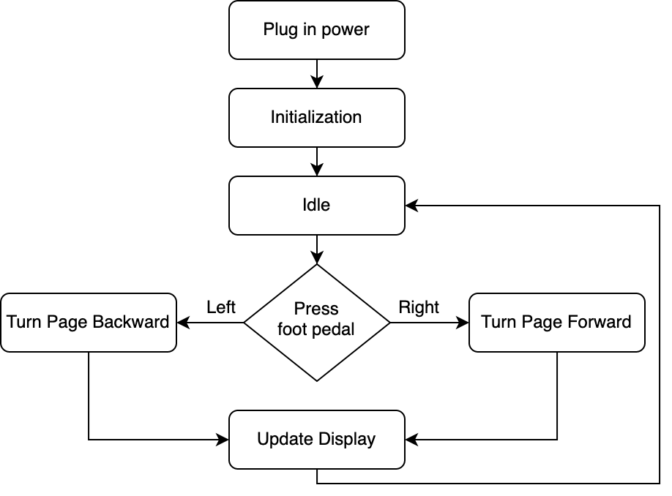
User Interface
Input
Foot pedal switches
Output
Motor actuation
LCD
ELECTRICAL & COMPUTER ENGINEERING
GRAINGER ENGINEERING
Notes:
Javi

Slide 24
Challenges
ELECTRICAL & COMPUTER ENGINEERING
GRAINGER ENGINEERING
Notes:
Javi

Slide 25
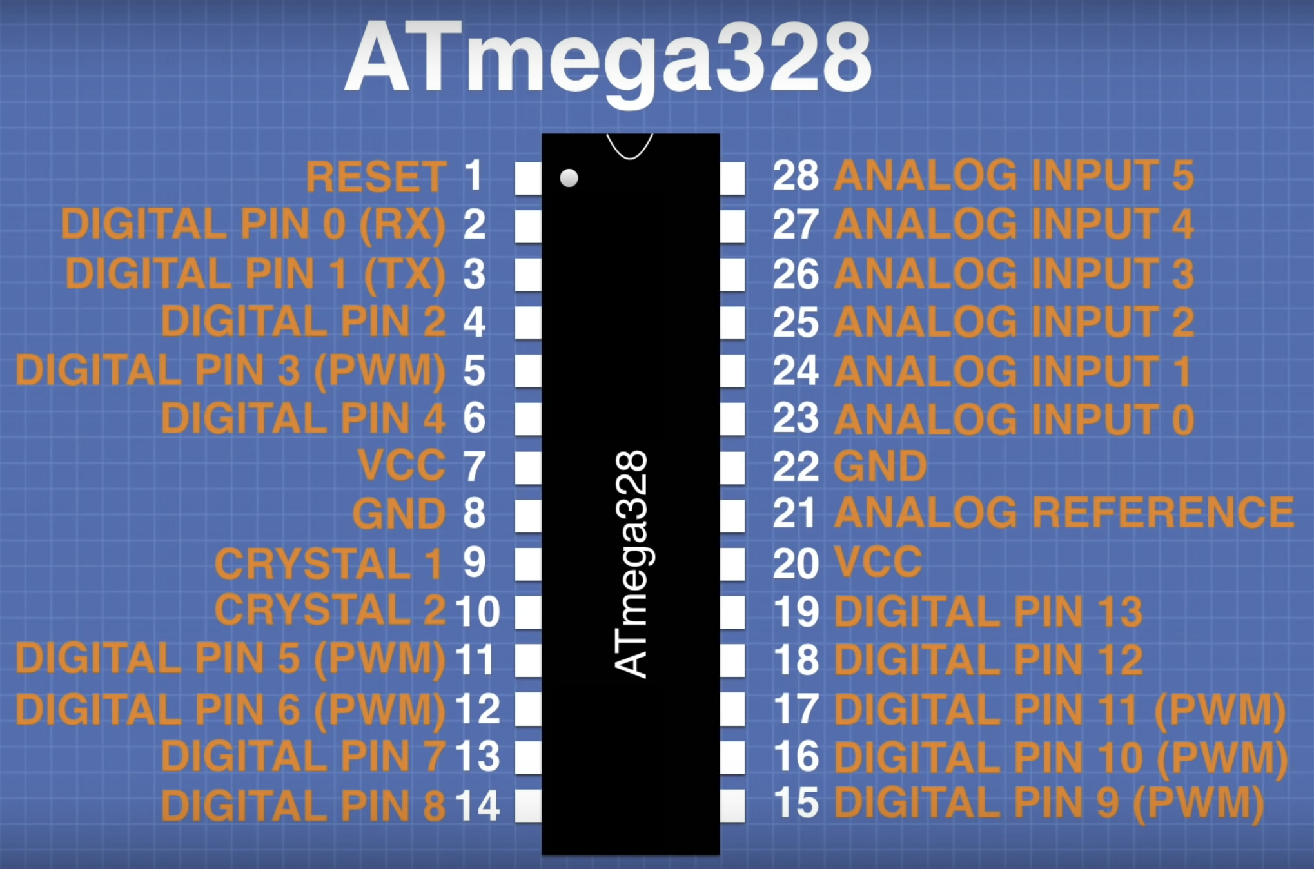
Programming Microcontroller
Burning Bootloader
Original MCU had issues
Hardware vs Software
Arduino software uses digital pins
Pin 2 maps to pin 0 in software
ELECTRICAL & COMPUTER ENGINEERING
GRAINGER ENGINEERING
Notes:
Javi

Slide 26
Physical Design
ELECTRICAL & COMPUTER ENGINEERING
GRAINGER ENGINEERING
Notes:
Adia

Slide 27
PCB Design
ELECTRICAL & COMPUTER ENGINEERING
GRAINGER ENGINEERING
Notes:
Adia

Slide 28
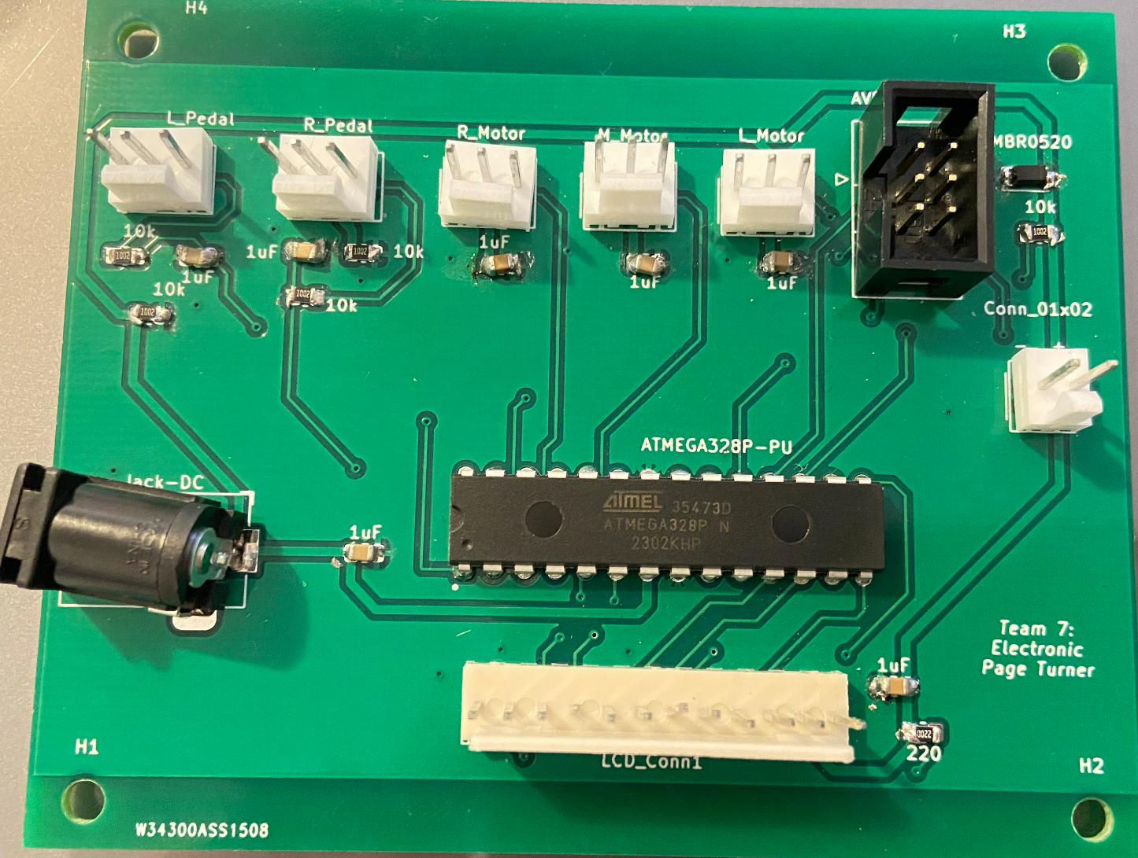
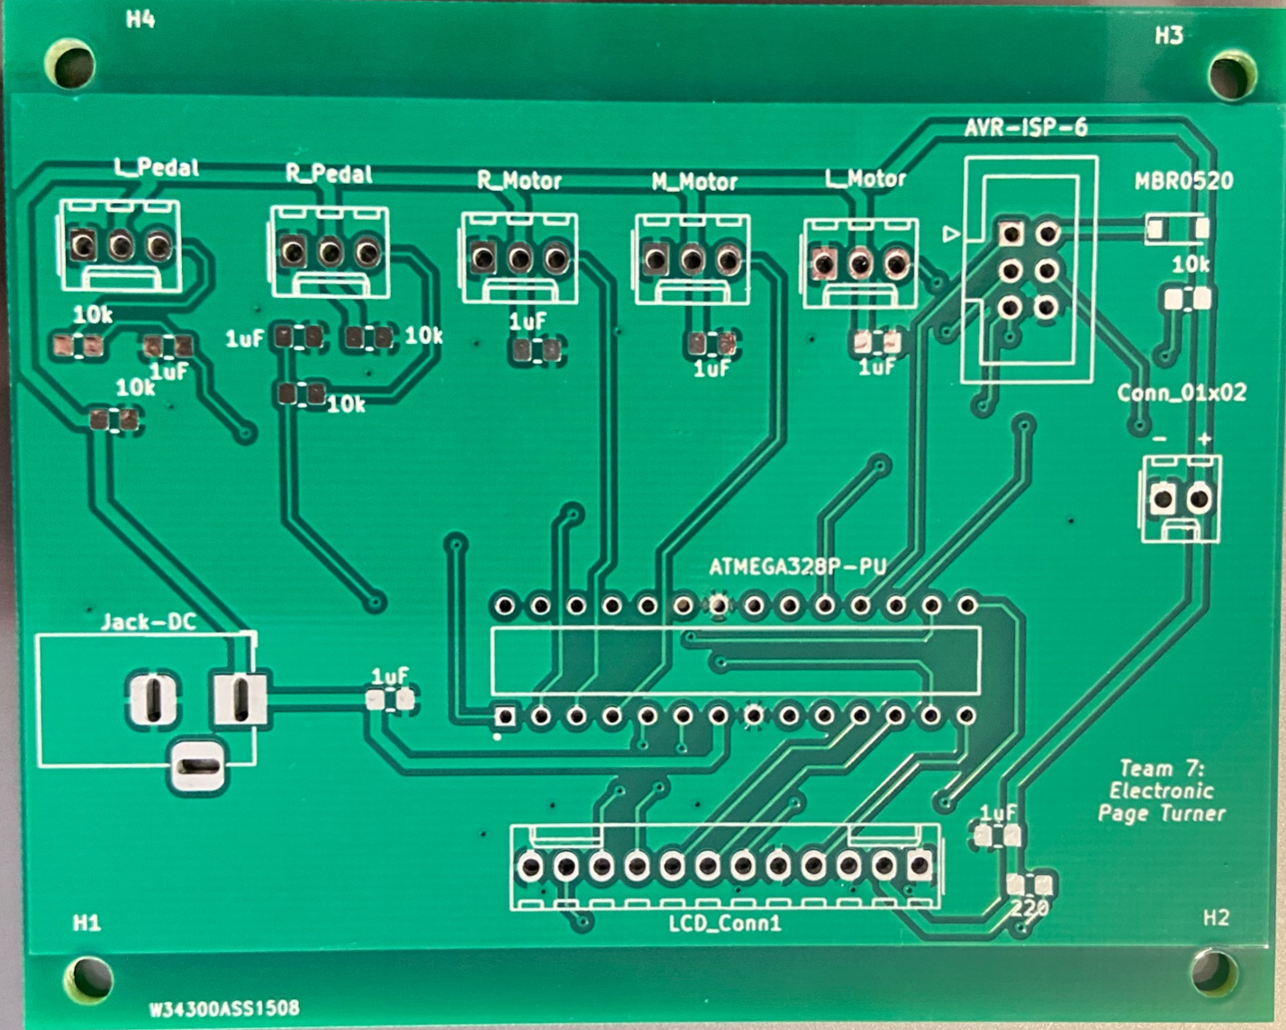
Physical Design
PCB Layout
Unsoldered PCB
Front Side of PCB
ELECTRICAL & COMPUTER ENGINEERING
GRAINGER ENGINEERING
Notes:
Adia

Slide 29
Challenges
ELECTRICAL & COMPUTER ENGINEERING
GRAINGER ENGINEERING
Notes:
Adia

Slide 30
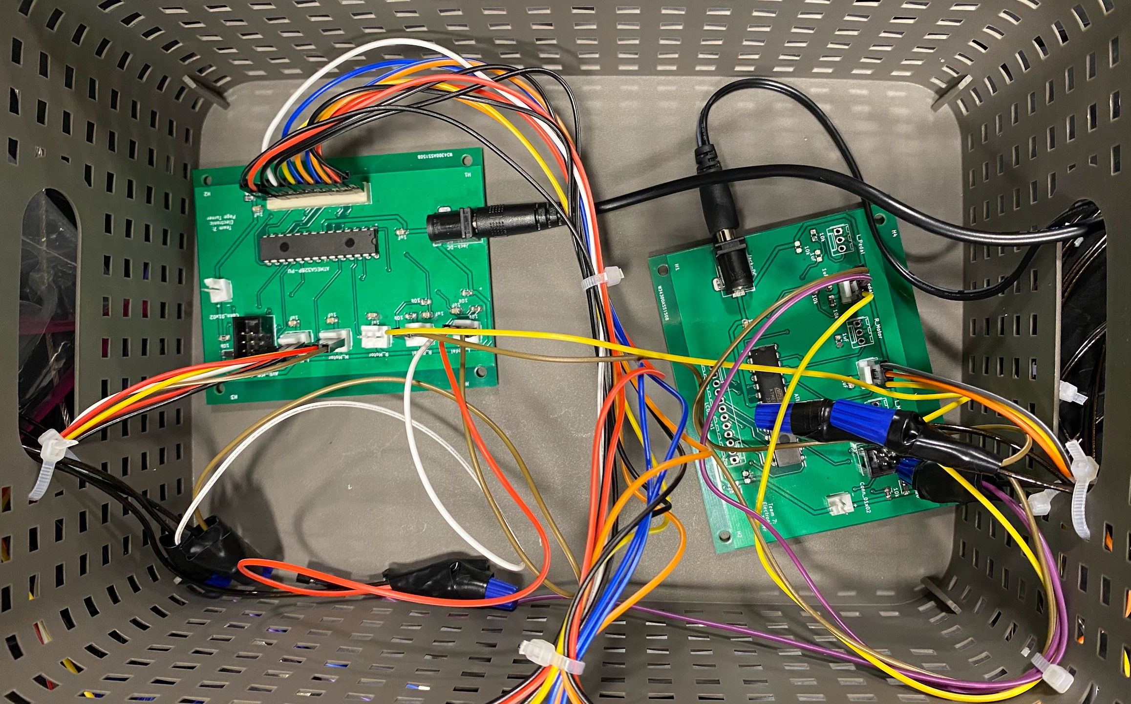
PCB Design
Foot Pedal
Pull-Up resistor on voltage line
Originally on data line
Microcontroller
Connect pin 3 to power
Instead of a via, draw the ground wire on pin 7
Motors
Add two capacitors for each motor
Helps with noise
ELECTRICAL & COMPUTER ENGINEERING
GRAINGER ENGINEERING
Notes:
Adia

Slide 31

Conclusion
What we learned and improvements to our device
ELECTRICAL & COMPUTER ENGINEERING
GRAINGER ENGINEERING
Notes:
Alyssa

Slide 32
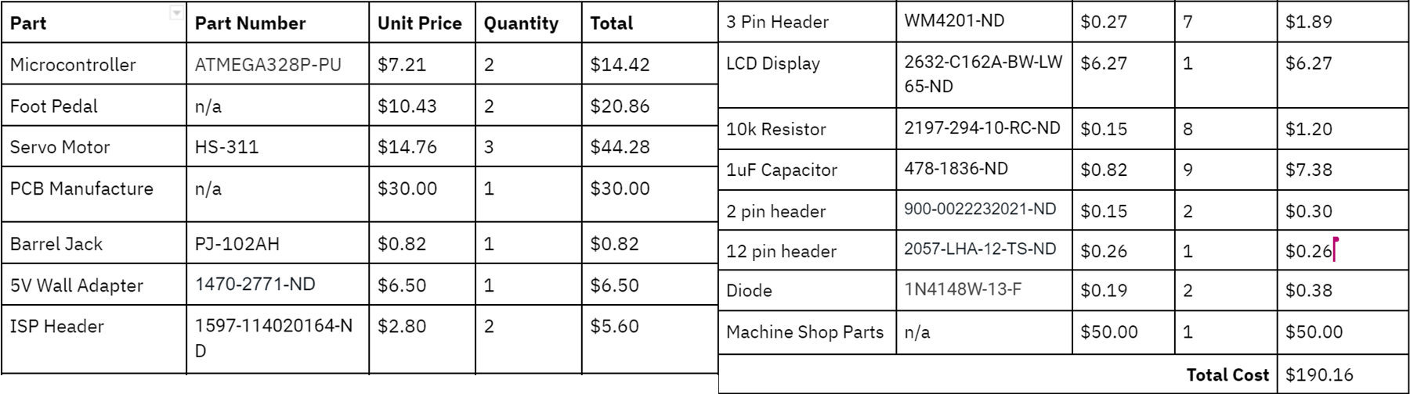
Cost
Cost Analysis
___________
ELECTRICAL & COMPUTER ENGINEERING
GRAINGER ENGINEERING
Notes:
Alyssa

Slide 33
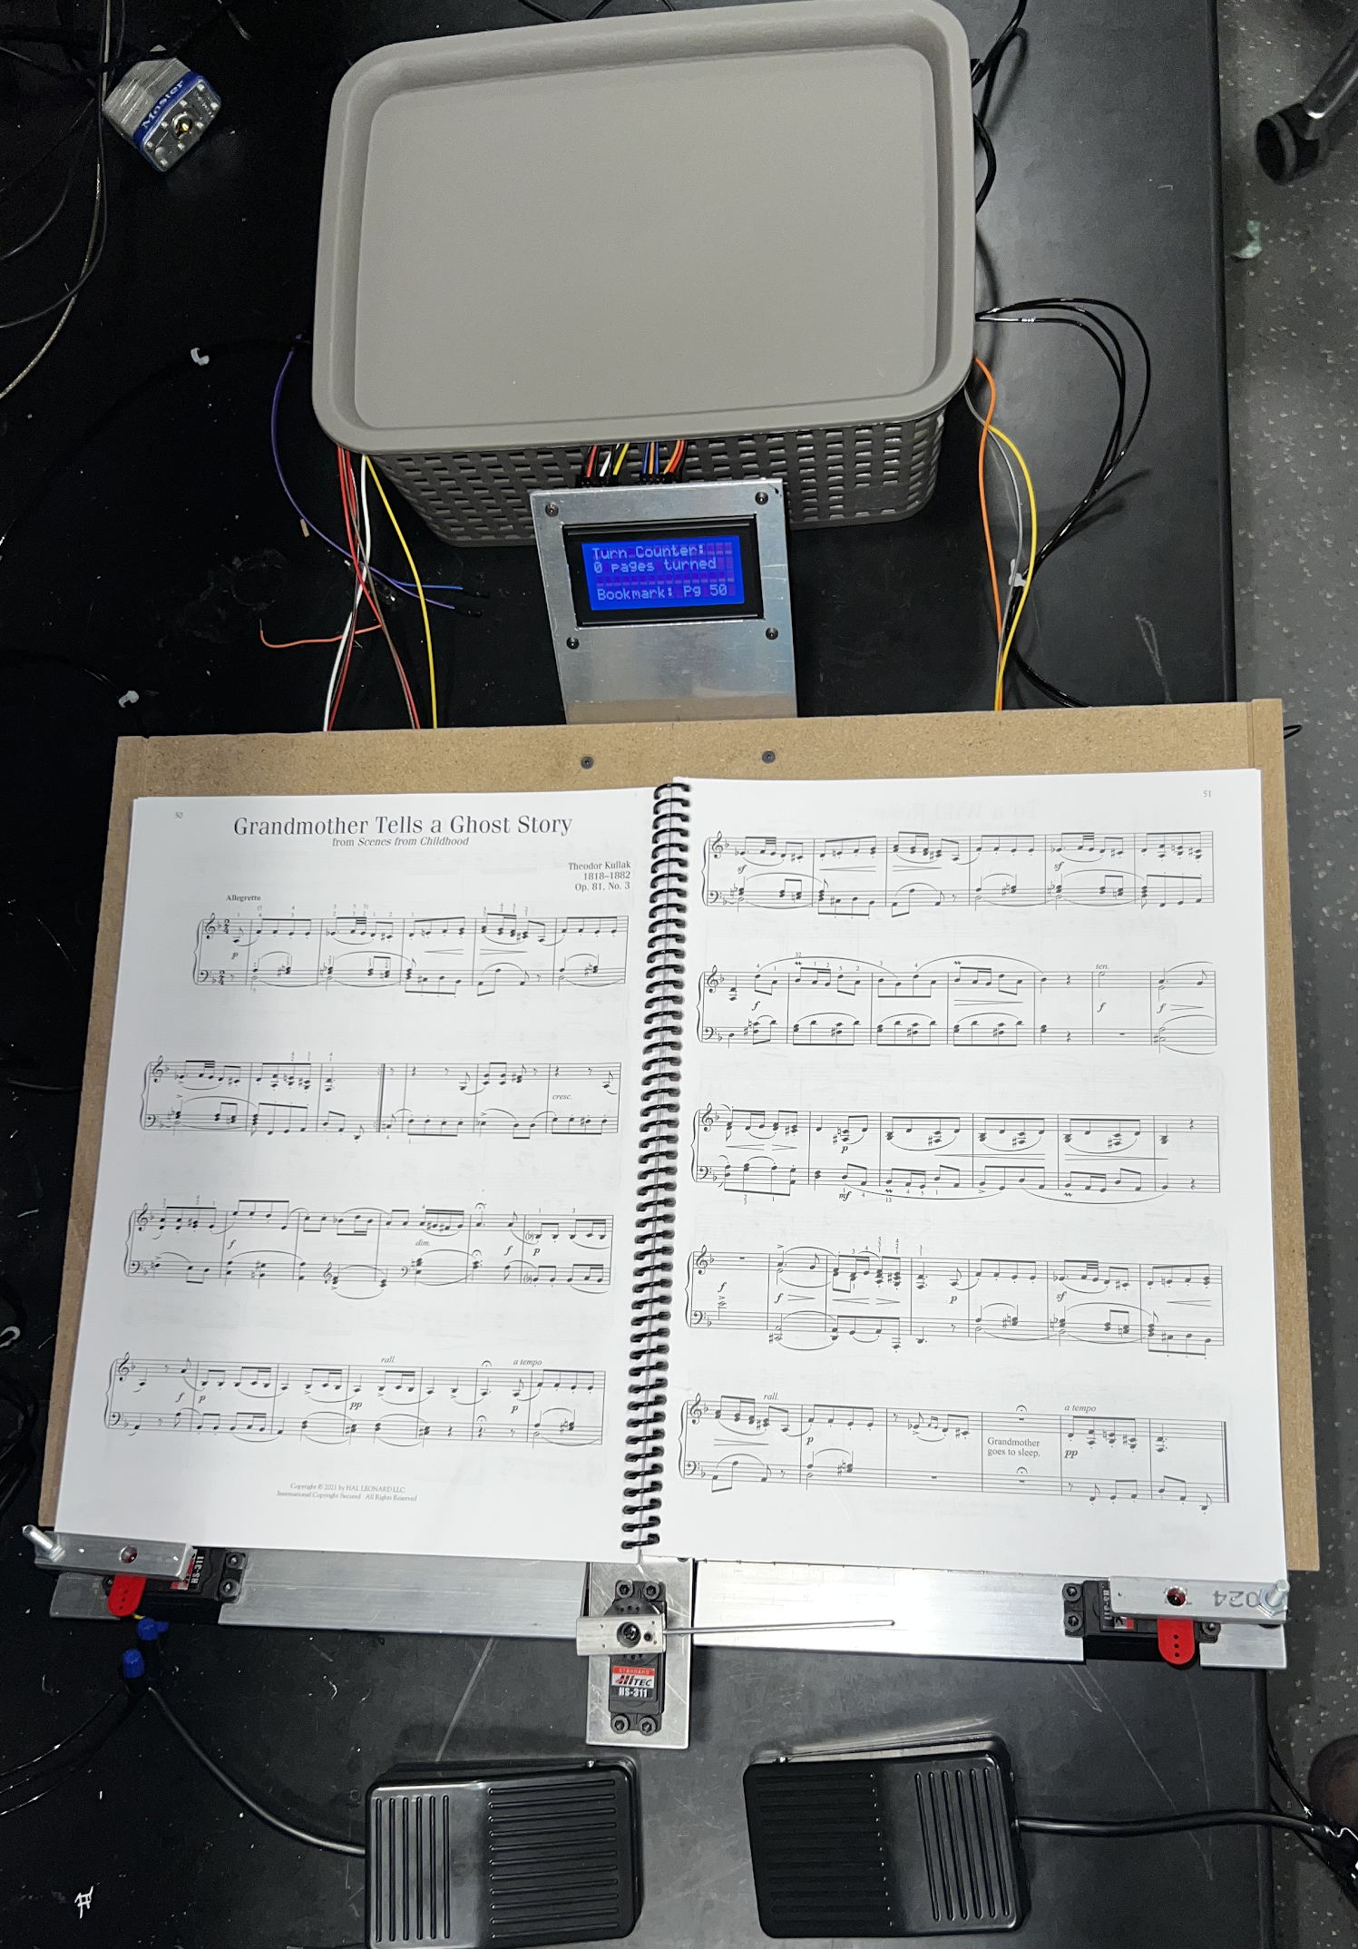
Summary
Accomplishments
Met all high-level requirements
Affordable compared to existing devices
Hands-Free
Recommendations for Further Work
Reset Button or Feedback loop to deal with page jamming
Force sensor to determine thickness of pages
Use only one PCB
ELECTRICAL & COMPUTER ENGINEERING
GRAINGER ENGINEERING
Notes:
Alyssa

Slide 34

Questions?
ELECTRICAL & COMPUTER ENGINEERING
GRAINGER ENGINEERING
Notes:
Alyssa

Slide 35


